Slide 1

BFX-AT100 LED issue 8D report
FOXCONN CPEG JBD_VN
Apr-13-2021

Slide 2
D1. Establish the Team
Team Leader
Team Member
ALT:
  QA Manager :
PM: Ben Zheng, Lam Zhou
PD: Ruan Wen Yong
QA: Rachel Nguyen, Robert Wu
SQE: Chun Ke
IE: Hai Ly
Foxconn
  MFG Manager : David Yin
  QA Manager : Charlie Su/ CB Lin

Slide 3

D2. Description of Problems
Issue Description
Feb-2021, ALT customer complain LED ( Yellow & Purple ) issue on RMA center:
20-Fed-2021, Everlight received from Fii 7 pcs LED issue ( Yellow & Purple) for analysis root cause and Fii retained 1 pc for analysis. The detailed information is as below:
ALT provided the RMA defect list on 02-April-2021 for LED defect q'ty : 636 pcs; Total deployed unit q'ty :830,000 -[2019.06~2021.03]
Type | SN | Production_Time | Vendor(Everlight) Lot Code | Vendor(Everlight) Date Code
Yellow | 2149688001201904040599 | 09/18/2019 15:50:01 | Y190730S1002DF | 190730
 | 2149688001201904024318 | 09/16/2019 05:40:20 | Y190730S1002DF | 190730
 | 2149688001201904032610 | 09/15/2019 16:02:53 | Y190730S1002DF | 190730
 | 2149688001201904017454 | 09/12/2019 08:20:13 | Y190730S1002DF | 190730
Purple | 2149688001201909023362 | 11/06/2019 16:21:41 | Y190914G1001DDFWX35 | 190914
 | 2149688001201908031823 | 10/12/2019 16:14:21 | LY190817S1002DDFWX35 | D190817
 | 2149688001201904035168 | 09/17/2019 03:01:02 | Y190730S1002DF | 190730
 | 2149688001201904041675 | 09/19/2019 03:15:47 | Y190730S1002DF | 190730

Slide 4

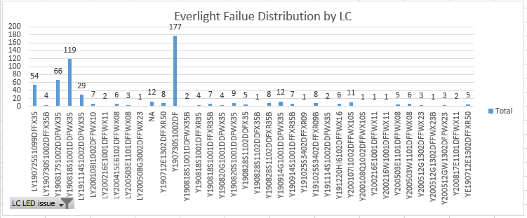
D3. Containment
Check 636 units ALT inform LED Fail
Check record Everlight material DC & LC of 636 pcs Customer defect LED issue as bellow:
Result : LED fail with DC190730 ( 30%) & DC190818 (21% ), and LC LY190818S1001DDFWX35 ( 20%) & Y190730S1002DF (30%). LED fail issue concentrate DC& LC 2019-July & 2019-Aug.

Slide 5


D3. Containment
Check production data and shipping data
Production data : 8 Units no have rework or repair data, all doing follow normal process:
TT | SN | Production_Time | Invoice_No | Shipping_Time
1 | 2149688001201908031823 | 10/12/2019 16:14:21 | 5028016106 | 10/17/2019 3:38:10 PM
2 | 2149688001201909023362 | 11/06/2019 16:21:41 | 5028016338 | 11/8/2019 8:07:30 PM
3 | 2149688001201904017454 | 09/12/2019 08:20:13 | 5028015723 | 9/12/2019 1:44:15 PM
4 | 2149688001201904024318 | 09/16/2019 05:40:20 | 5028015801 | 9/18/2019 4:00:13 PM
5 | 2149688001201904035168 | 09/17/2019 03:01:02 | 5028015801 | 9/18/2019 4:00:13 PM
6 | 2149688001201904040599 | 09/18/2019 15:50:01 | 5028015800 | 9/18/2019 4:15:54 PM
7 | 2149688001201904032610 | 09/15/2019 16:02:53 | 5028015802 | 9/19/2019 5:04:34 AM
8 | 2149688001201904041675 | 09/19/2019 03:15:47 | 5028015802 | 9/19/2019 5:04:34 AM
Checking technique: Check LED color at FT test following SOP/ Quality alert and use golden sample for comparison.

Slide 6
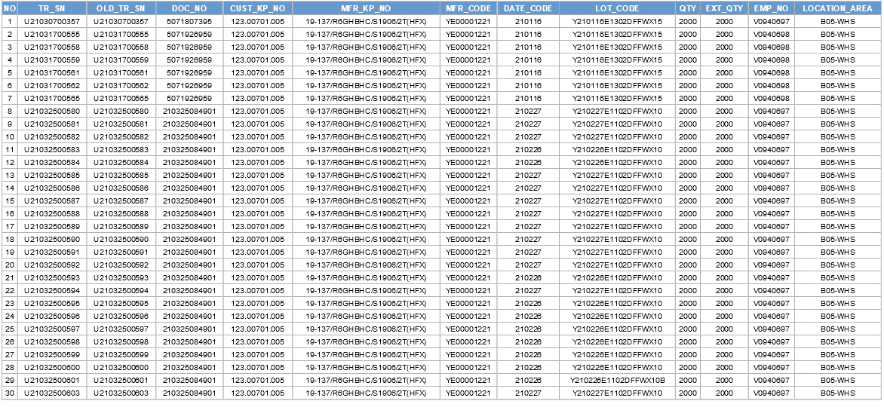
D3. Containment
Check all LED Material in Warehouse with 123.00701.005 – 26-Mar-2021 .
Result : Check 60K material ( 123.00701.005 ) Everlight vendor in warehouse , All is DC 202101 and 202102. No DC 190730, 190914, 190817 Led issue.

Slide 7
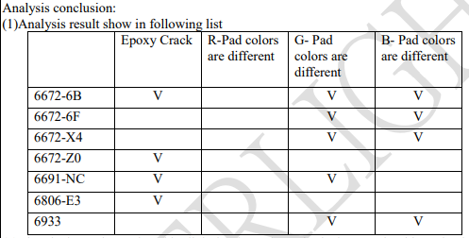

D4. Root Cause ( Everlight FA)
FA report 7 pcs NG sample analysis
(2)Electrical test shows the white light luminous intensity is decay. G/B chip pad color is abnormal, and IR (leak current) is found.
(3)6672-X4(yellow)/6672-6F(yellow)/6933(Purple) feedback to chip supplier confirm .
(4)3/3 chip supplier confirmed and replied that there was no abnormality in bare crystal.
(5)After selecting 6672-6B, the internal situation was confirmed and no abnormality was found.
(6)The electrical properties of bare crystal were not abnormal.
(7)The material was confirmed by EDX(Energy-Dispersive X-Ray Spectrometer), which confirmed that the silver powder of the silver
glue was attached to the P/N Junction causing a leakage current condition.

Slide 8
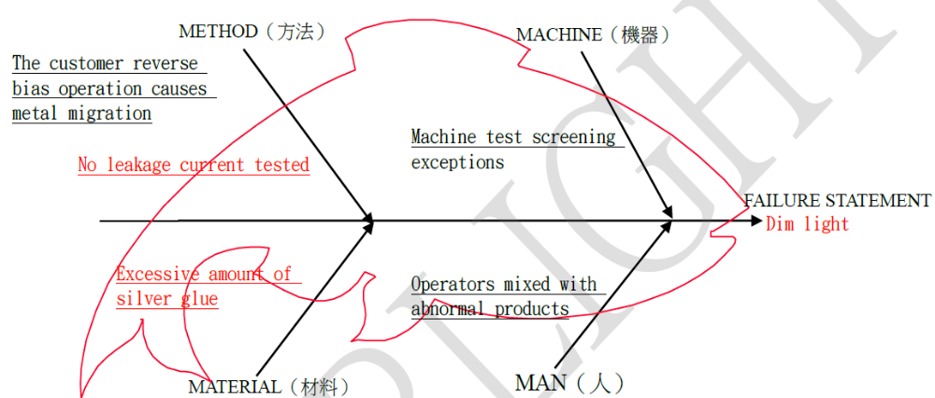
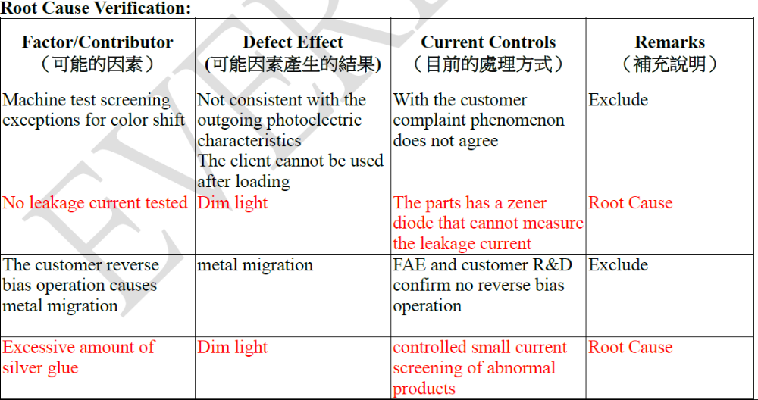
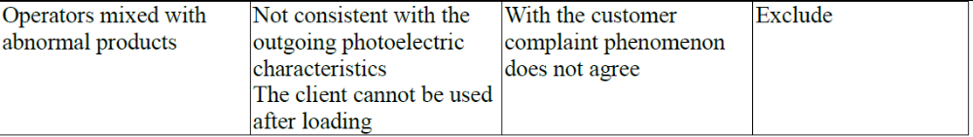
D4. Root Cause ( Everlight FA)
Define the root cause from fishbone diagram analysis

Slide 9
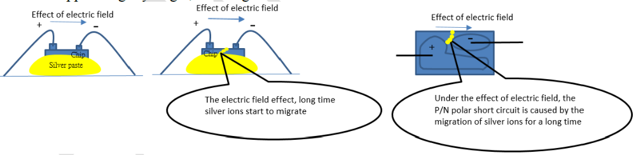
D4. Root Cause ( Everlight FA)
Analysis conclusion
Analysis conclusion:
Everlight_FAE and Foxconn discuss the design of the circuit. The circuit is as follows:
Verify that there is no reverse bias in the circuit ----eliminate the problem of using reverse voltage。
Cause: The possible reason is that the volume of sliver paste is higher, and it close with the P/N Junction area causing a small leakage current condition.
During the shipment test, the chip leakage current value could not be tested because the model contained Zener diode
When the amount of silver glue is too high in production, the wafer will produce a tiny leakage current. After a long time of application, the silver ions in the silver glue will stick to the P/N Junction of the wafer and appear slightly bright, resulting in color bias.
Reason of outflow: The product has an Zener diode. The leakage current of the chip end cannot be tested during the electrical test in the factory, resulting in such abnormal loss。

Slide 10
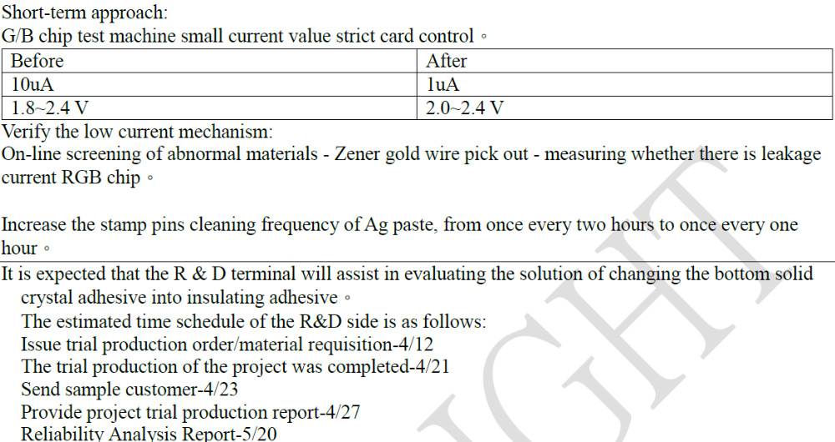
D5. Corrective Action ( Everlight vendor action)
Everlight will introduce the short solution right away. The validity will be verified by 4/23
The long term solution will be introduced to eliminate the customer concern.

Slide 11



D6. Verification of effectiveness
Quality alert and SOP were already updated inspection requirement and hang on production line, IPQC keep audit and verifying the implementation on production line.
SOP check LED on Test Function
FT1 Test Station | FT Test Station | RC Test Station | OBA Test Station | Quality Alert

Slide 12
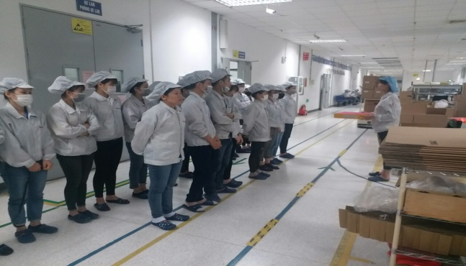
D7. Prevent recurrence
Line leader remind all operators before production and monitor their operating daily.
IPQC will random sample check all test station and OBA station follow AQL .
Owner: PD/PQE: Huu Loi, Luu Mien

